Slide 1
Unit 12 Time Series
Adding Covariates

Slide 2
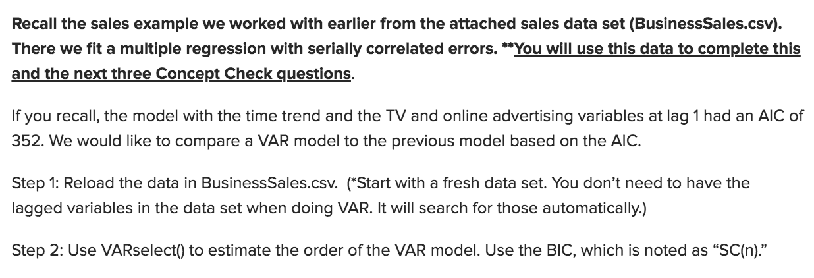
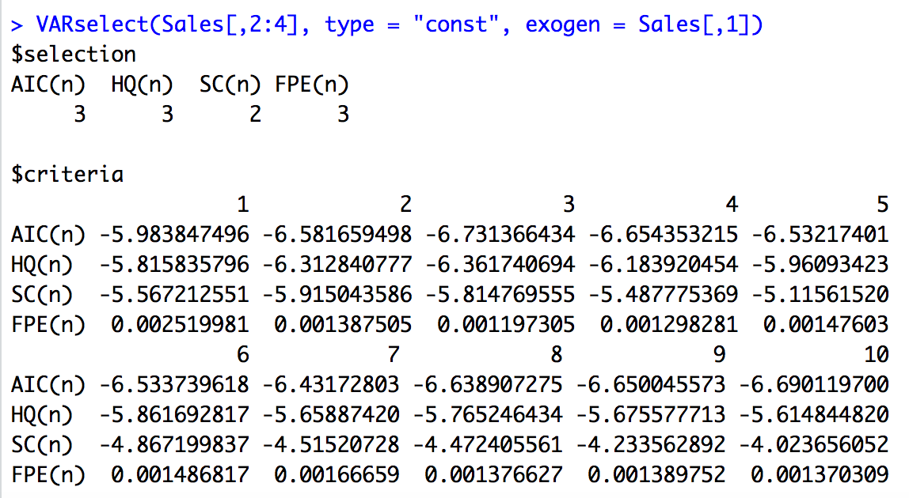
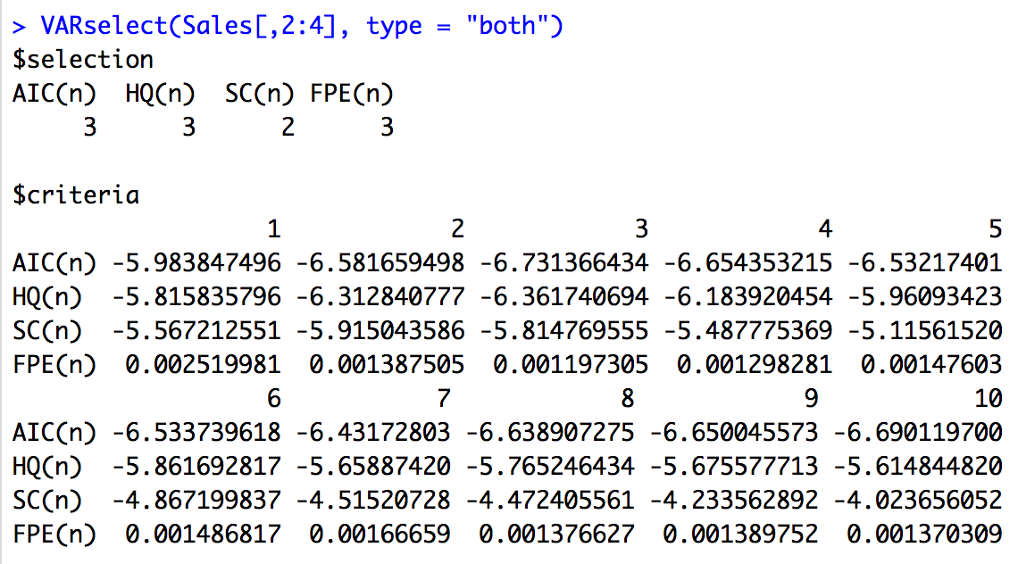
Review of Melanoma and Sunspot Concept Check

Slide 3



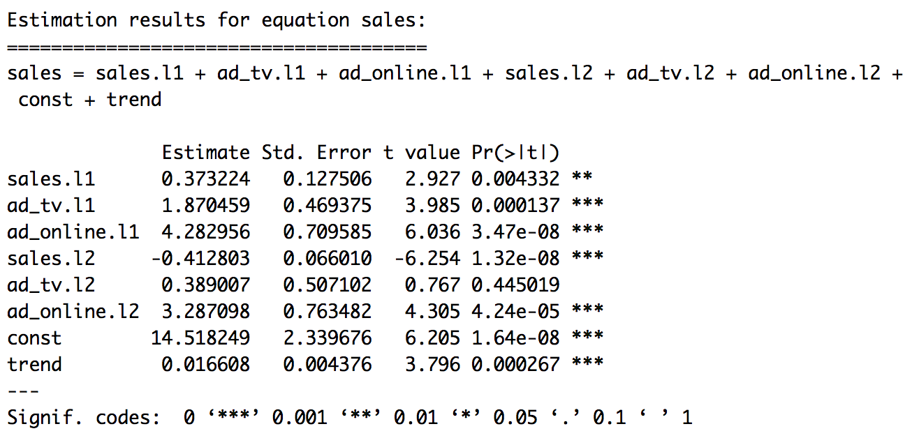
Review of Melanoma and Sunspot Concept Check

Slide 4


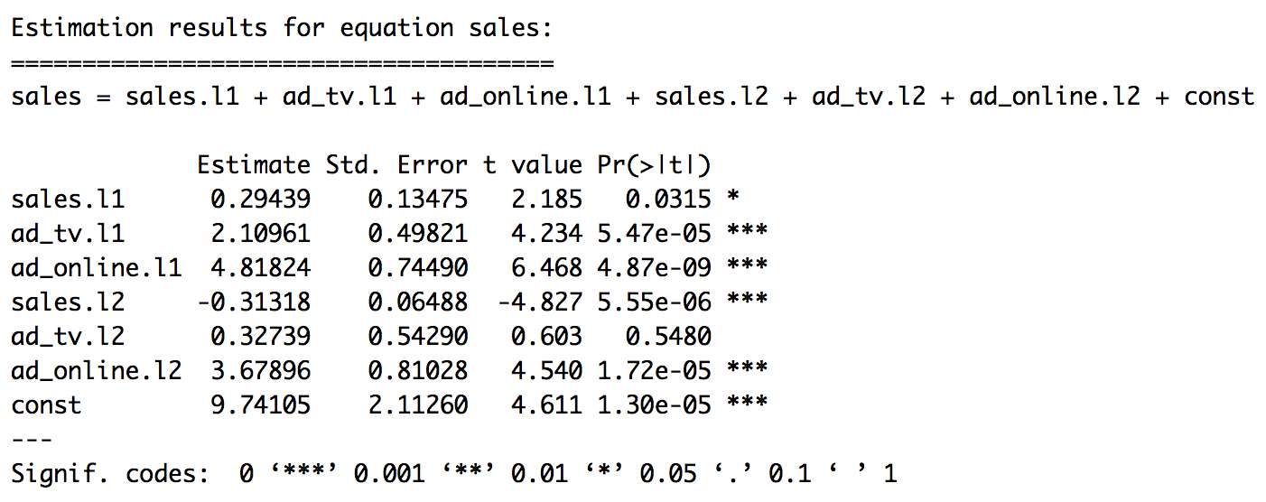
Review of Melanoma and Sunspot Concept Check

Slide 5


Review of Melanoma and Sunspot Concept Check

Slide 6
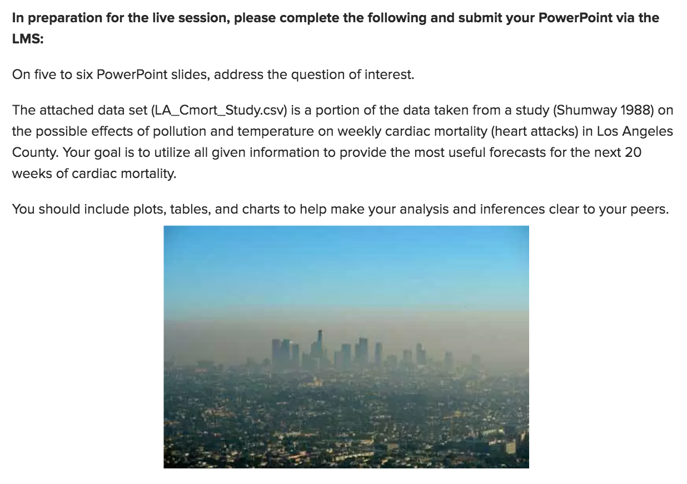
Break Out 1: LA Pollution Data

Slide 7
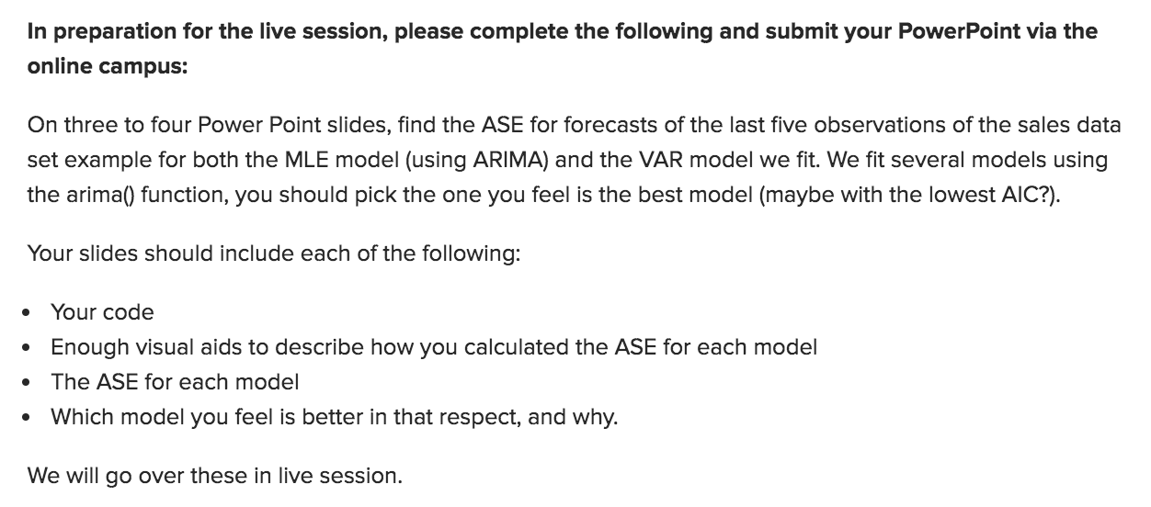
Break Out 2: Sales Data and ASE

